Slide 1












Bangladesh’s Economic Landscape : The Role of Inflation

Slide 2
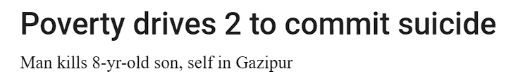
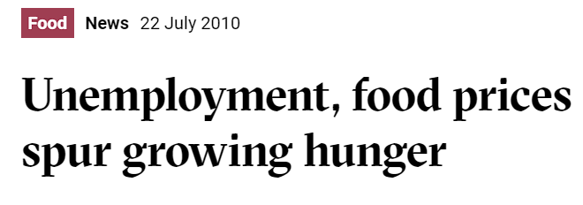
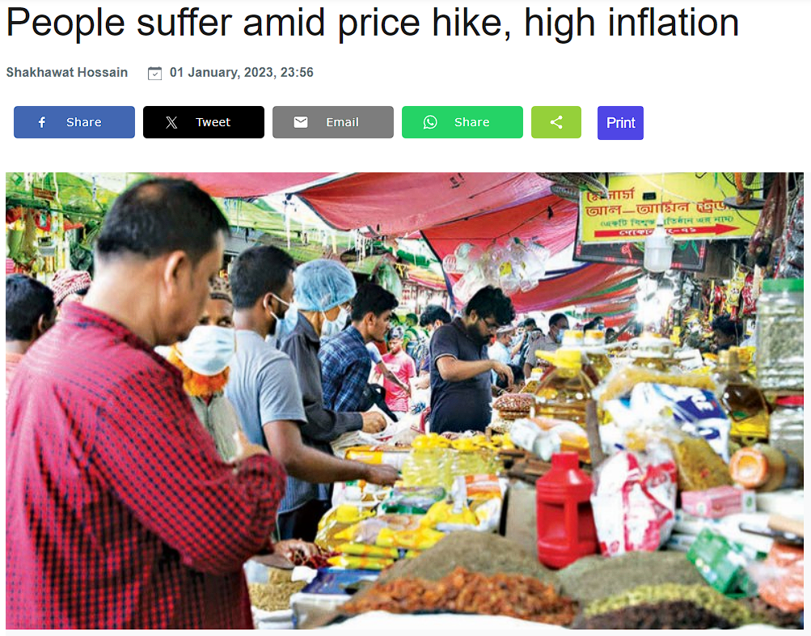

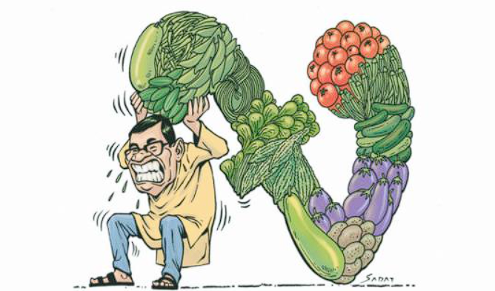

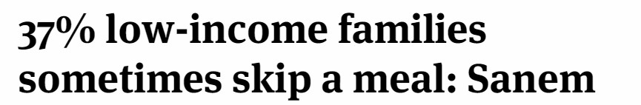
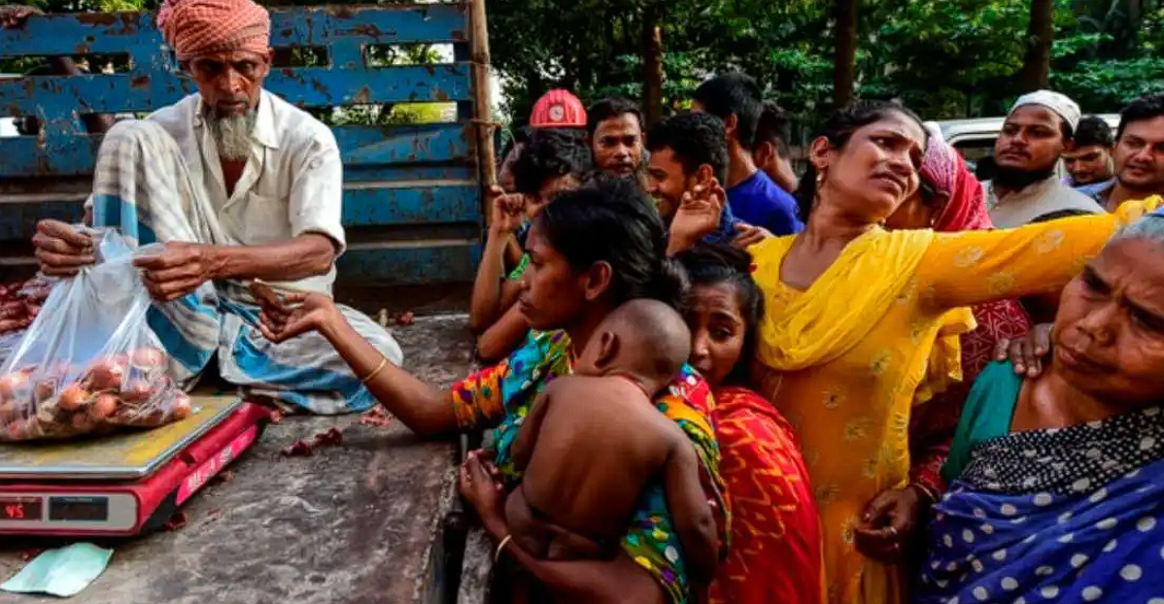
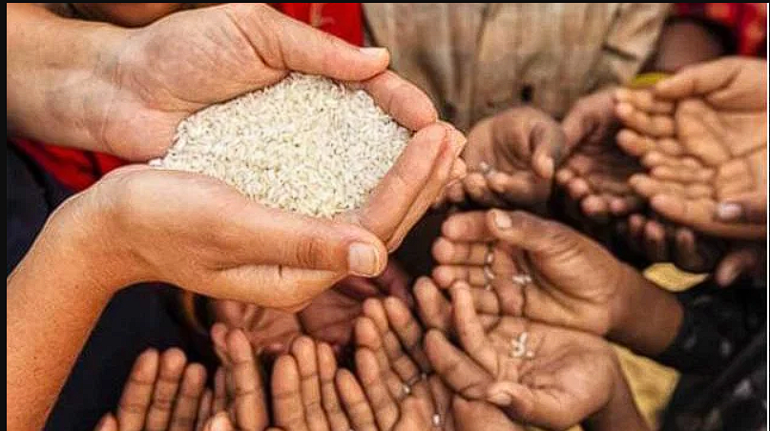
PROBLEM BACKGROUND AND MOTIVATION

Slide 3
Research Questions
What are the factors that drives inflation in Bangladesh ?
How does inflation affect different sectors of the Bangladeshi economy?
What strategies can be implemented to mitigate inflation in Bangladesh?

Slide 5


RELATED STUDIES
RESEARCH OBJECTIVE
Biswas, G. K et al. (2023)
01
Discussed about the factors in inflation.
01
Find the factors behind Inflation
Hossain, M et al. (2020)
02
Discussed about the affecting sectors.
02
Defying affected Sectors
Islam, M. S et al. (2024)
03
Discussed about strategies to solve the problem
03
Mitigating Strategies

Slide 6
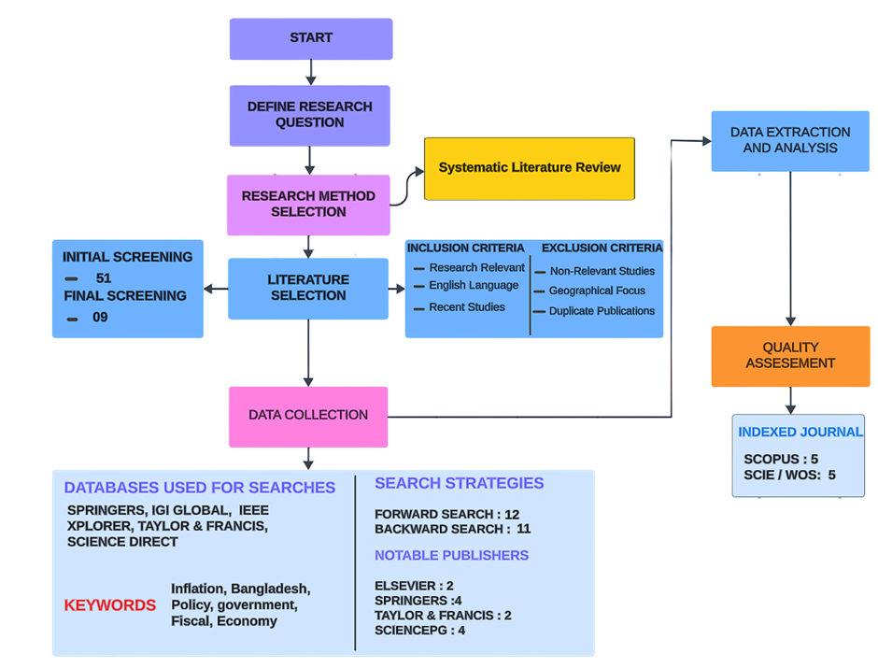
METHODOLOGY
WHY SLR?
01
Comprehensive and Evidence-Based
02
Why This Matters
STEP 01
STEP 02
STEP 03
STEP 04

Slide 7
DATA COLLECTION & RESEARCH STRATEGIES
KEYWORDS USED
TOTAL PAPERS
Inflation
Bangladesh
Policy
5
2
2
Government
Fiscal
Economy
SPRINGER
SCIENCE DIRECT
TAYLOR & FRANCIS
STEP 01
STEP 02
STEP 03
STEP 04

Slide 8
INCLUSION &
EXCLUSION CRITERIA
INCLUSION CRITERIA
EXCLUSION CRITERIA
1
Articles published within the last 10 years were prioritized to ensure up-to-date information.
1
Studies that did not specifically focus on inflation in Bangladesh or its economic impact were excluded.
2
Studies published in English were selected for consistency in understanding.
2
Studies published more than a decade ago were excluded.
STEP 03
STEP 04
3
Studies discussing the economic and fiscal policies related to inflation in Bangladesh were included.
3
If the same research group had multiple publications on the same topic, only the most recent and comprehensive one was included.
STEP 01
STEP 02

Slide 9
Data Extraction & Quality Assessment
Journal Impact Factors
Database Coverage
Scopus: 5 papers
Web of Science (SCIE): 5 papers
Cross-Referencing with Similar SLRs
Credibility Assurance
STEP 01
STEP 02
STEP 03
STEP 04

Slide 10
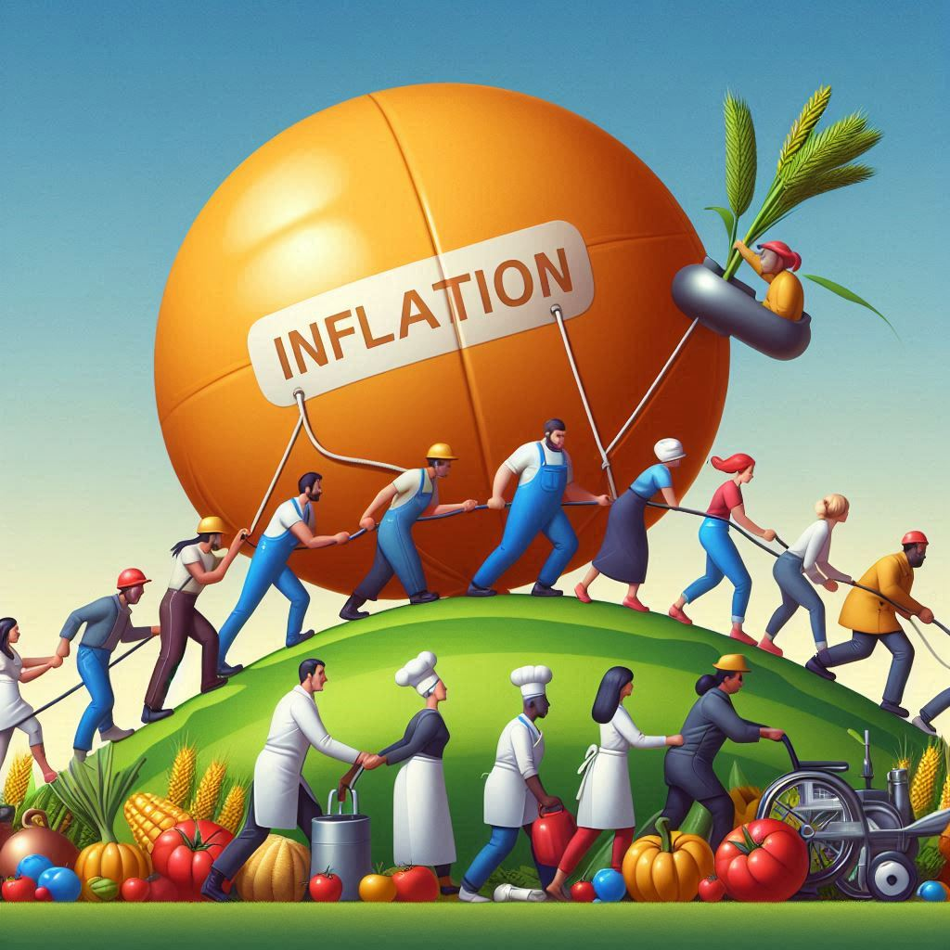
Results & Analysis
Main Drivers of Inflation
01
Initial Influence
Domestic Money Supply
02
Current Trends
Rising Oil Prices
Global Market Volatility

Slide 11
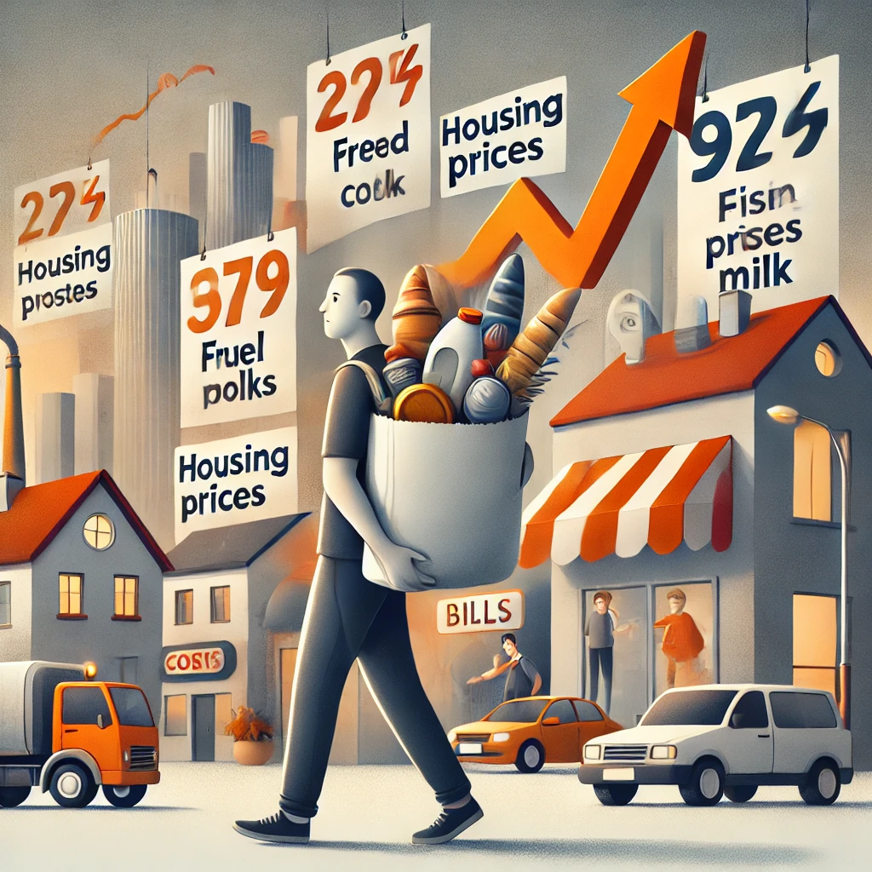
Results & Analysis
Impact of Inflation
01
Vulnerable Population
Agriculture
Low-income Households
02
Current Trends
Limited Access to Basic Goods
Exacerbation of Poverty

Slide 12
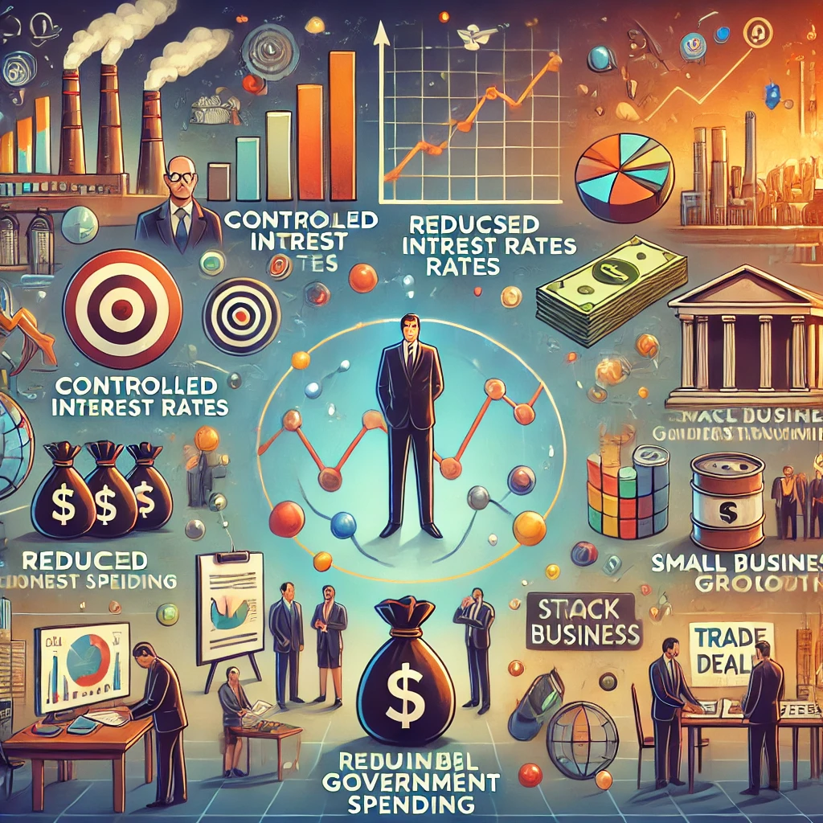
Results & Analysis
Strategies for Mitigation
Enhance Monetary Policies
Stabilize Exchange Rates
Boost Agricultural Productivity
Pursue Structural Reform

Slide 13

Conclusion
01
Economic Threat
Inflation continues to threaten economic stability and poverty reduction.
02
Key Findings
Excessive money supply, global commodity prices, and government spending are major inflation drivers.
03
Immediate Action
Need for immediate policy action to stabilize prices and protect vulnerable populations.
04
Call for Collaboration
Collaboration between policymakers, economists, and international bodies to implement long-term solutions.

Slide 14

Future Scope
Future Scope of Research on Inflation in Bangladesh
01
Sector-Specific Impacts
Explore inflation’s long-term effects on sectors like agriculture, informal labour, and SMEs.
02
Policy Innovation
Study innovative fiscal and monetary policies that can stabilize inflation.
03
Comparative Analysis
Analyse inflation control strategies from other developing economies.
04
Technology’s Role
Investigate the impact of digitization and AI on inflation tracking and economic forecasting.

Slide 15
THANK YOU
ANY QUESTIONS?

